Slide 1
CYBERTRAINING 2026 • CAPSTONE PROJECT
ML Approximation of Hessian Components
for Accelerated CASSCF Optimization
Toward Resonating Hartree-Fock
Qabas Mohammad Al Khatib (PhD candidate) Department of Chemistry, Case Western Reserve University Advisor: Dr. Shane M. Parker
1

Slide 2
MOTIVATION
Why Hessian Information Matters
1
Resonating Hartree-Fock (ResHF) is designed for strongly correlated systems using nonorthogonal Slater determinants.
2
Its optimization simultaneously adjusts both orbital coefficients and CI weights — a fully coupled, nonlinear problem that often fails to converge.
3
Second-order methods (like Newton-Raphson) use the Hessian for reliable convergence, but computing the exact Hessian is very expensive.
4
This project asks a practical question: Can machine learning approximate key Hessian components from much cheaper features, starting with CASSCF as a testbed?
2

Slide 3
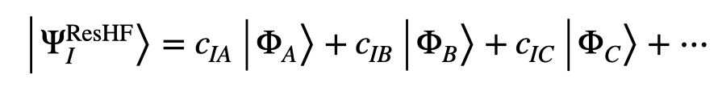

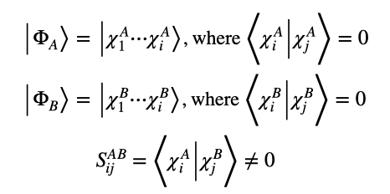
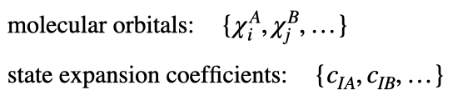
Introducing Resonating Hartree-Fock (ResHF)
ResHF Wave Function: A linear combination of nonorthogonal Slater determinants
With nonorthogonal sets of molecular orbitals:
Optimization involves both:
, where
Fukutome, H. Theory of resonating quantum fluctuations in a fermion system: Resonating Hartree-Fock approximation. Progress of Theoretical Physics 1988, 80, 417–432.
Notes:
let’s move into the main theory I work with: Resonating Hartree–Fock, or ResHF.
ResHF wavefunction is a linear combination of nonorthogonal Slater determinants.
Each determinant is built from its own set of orbitals, and all these orbitals are orthonormal.
In ResHF, we don’t just optimize one determinant, we solve for both the molecular orbitals for each determinant as $φ_{A}$, $φ_{B}$) and the state expansion coefficients (C_{IA}) that tell us how much of each determinant is in the final wavefunction.
But there’s a problem. ResHF struggles to converge for larger or more complex systems.

Slide 4
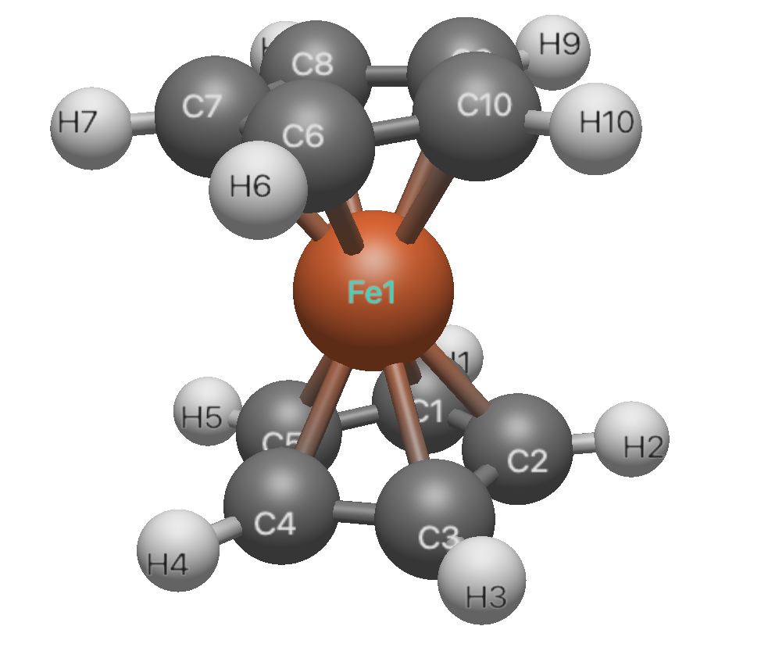
MOTIVATION
The Hessian Cost Problem
Example: ferrocene, SCF-NR/ def2-SVP
Basis functions
Full Hessian size
n = 221
8,304 × 8,304 ≈ 69 million entries
Electrons
96 → occupied orbitals n_occ = 48
Virtual orbitals
n_vir = n − n_occ = 221 − 48 = 173
Full Hessian size: ~69 million entries; rebuilt (or inverted) at every optimization step.
rotation-space dimension
n_occ × n_vir = 48 × 173 = 8,304
This is why exact second-order methods become impractical for larger systems.
4

Slide 5
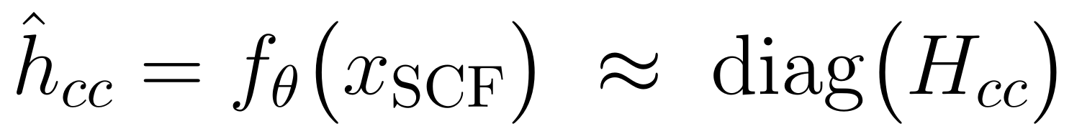
THE APPROACH
The Core Idea
Can cheap SCF-level features predict expensive Hessian information?
Cheap SCF Features
ML Model
CI Hessian Diagonal
12 low-cost features
(gradients, energies,
norms, statistics)
PyTorch Feedforward Neural Network
12 → 64 → 64 → 400
400-diminsional ci_hdiag
(approximated)
Hypothesis: cheap SCF-level descriptors contain enough information to approximate diagonal Hessian curvature
5

Slide 6
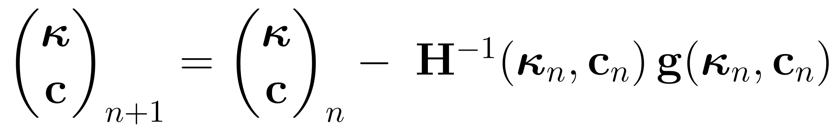
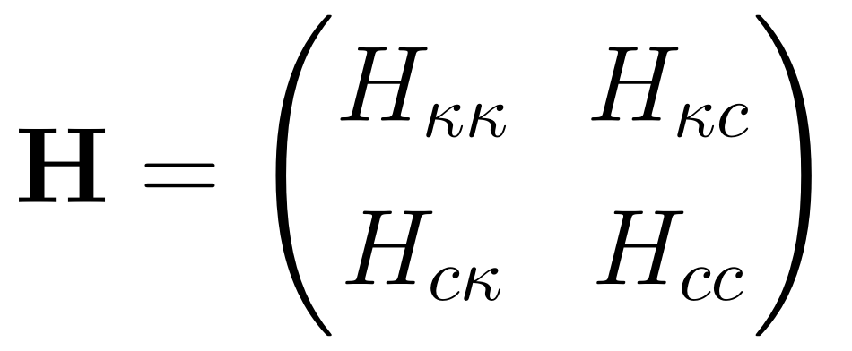


FORMULATION
Second-order optimization solves the coupled Newton-Raphson update:
$H$is the full Hessian and $g$is the gradient.
Full Coupled Hessian
Our Capstone's ML Target
We focus on the CI Hessian diagonal block ($H_{cc}$), specifically the vector ci_hdiag.
This part is readily available from PySCF.
Not addressed in this project: The full orbital-CI coupling block ($H_{κc}$).
This is a genuine limitation of the current PySCF interface, not an oversight.
κ =orbital rotation parameters, c = CI coefficients
6

Slide 7
DATA
Data: CASSCF Data Generation
INVEST Molecule Set: Pollice et al., Matter 4, 1654–1682 (2021)
20 / 23
(6,6)
12
molecules converged (of staged)
active space, def2-SVP basis
SCF-level input features
Held-Out Test Molecules (6)
S1000
S1200
S1180
test molecule 1
test molecule 2
test molecule 3
S1010
S1050
S1090
test molecule 4
test molecule 5
test molecule 6
14 additional molecules used for training, drawn from the same INVEST benchmark set
train/test split — verified
X_train, X_test, y_train, y_test, names_train, names_test = train_test_split(
X, y, np.array(names), test_size=6, random_state=42
)
7

Slide 8
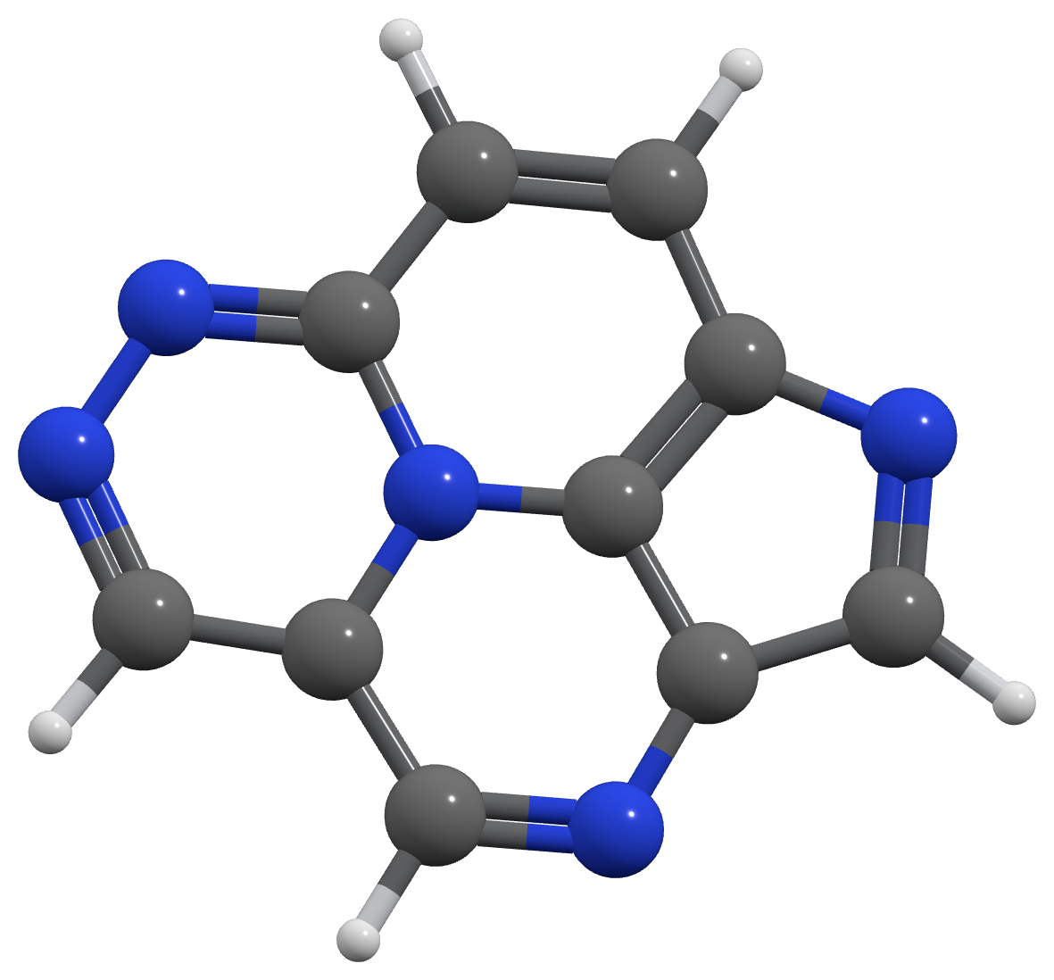
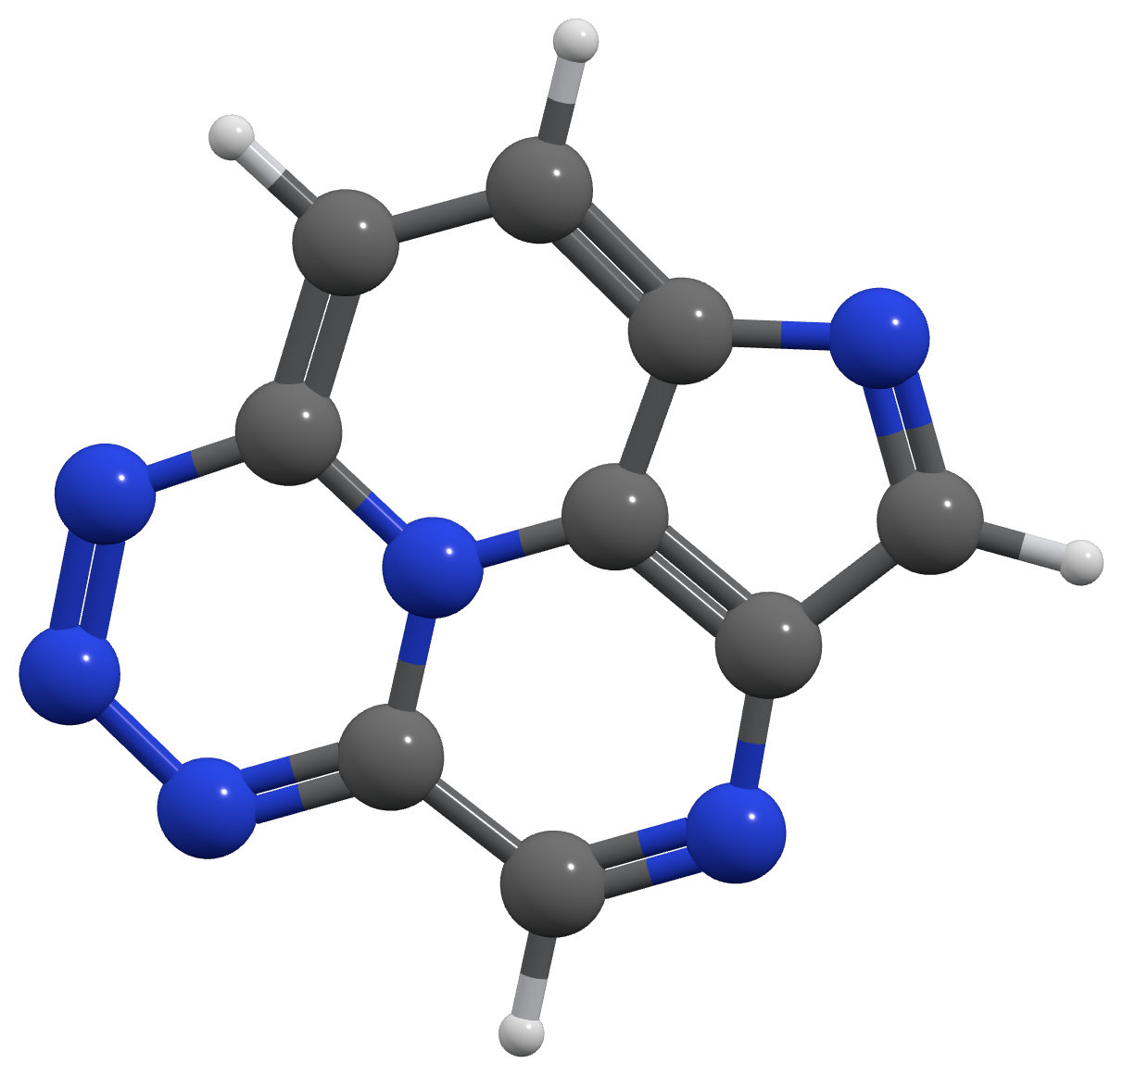
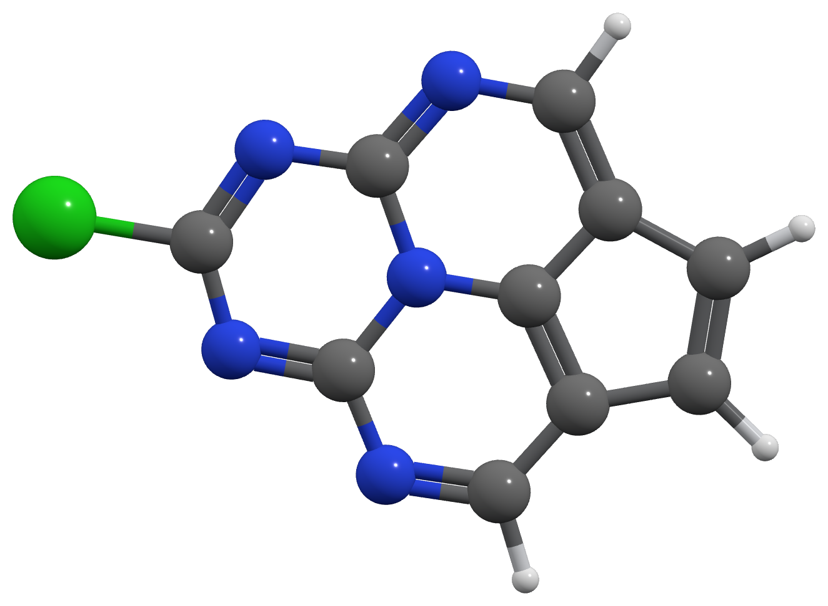
DATA
Sample INVEST Molecule Structures
Representative structures from the nitrogen-rich fused-ring INVEST scaffold set
S1000
S1010
S1120
Nitrogen-rich, fused polycyclic frameworks with varying substitution patterns — consistent with the structural diversity of the Pollice et al. INVEST benchmark set.
8

Slide 9
DATA PIPELINE
Feature Engineering
Because orbital space sizes vary across molecules, we summarize the data into 12 fixed-size features per molecule:
Gradient statistics (g_orb)
Hessian-diagonal statistics
CI coefficient statistics
Vector norms
Total energy
Active-space size descriptors
from sklearn.model_selection import train_test_split
from sklearn.preprocessing import StandardScaler
scaler_X = StandardScaler(); X_train_scaled = scaler_X.fit_transform(X_train)
scaler_y = StandardScaler(); y_train_scaled = scaler_y.fit_transform(y_train)
feature_engineering — verified
14
training molecules
6
held-out test
This creates a consistent input for the neural network.
9

Slide 10
METHODS
Two Models Compared
Note: These solve different prediction tasks, not a direct architecture comparison.
PyTorch FFNN — Full Target
ChemML MLP — Baseline Proxy
12 → 64 → 64 → 400
12 → 64 → 64 → 1
Predicts the full 400-dimensional ci_hdiag vector
ReLU hidden layers · MSE loss
Single-output regression by design
predicts only the mean of ci_hdiag
chemml baseline — verified notebook code
from chemml.models import MLP
model_chemml = MLP(
engine='pytorch', nfeatures=12, nneurons=[64, 64, 1],
activations=['ReLU', 'ReLU', 'linear'], learning_rate=0.001,
nepochs=2000, batch_size=14, loss='mean_squared_error',
is_regression=True, opt_config='adam'
)
10

Slide 11
RESULTS
Model Comparison
PyTorch achieves significantly lower error (5.30%) compared to the ChemML baseline (21.61%).
Note: The models solve different prediction tasks (see Methods).
S1000: Actual=0.9426, Pred=1.1350
Error=20.41%
S1200: Actual=0.8295, Pred=1.0811
Error=30.33%
S1180: Actual=0.8610, Pred=0.8682
Error=0.83%
S1010: Actual=1.2144, Pred=0.4546
Error=62.56%
S1050: Actual=-1.3183, Pred=-1.1160
Error=15.35%
S1090: Actual=-1.7744, Pred=-1.8609
Error=4.87%
PyTorch overall: 5.30%
ChemML overall: 21.61%
11

Slide 12
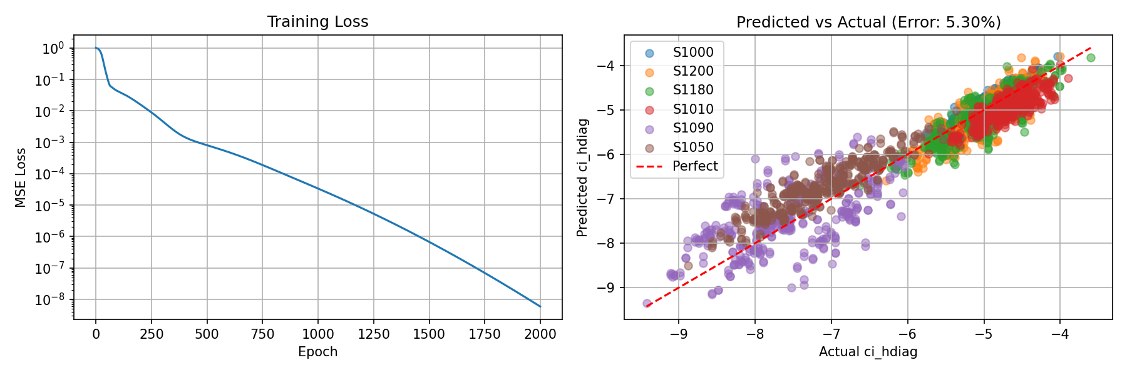
RESULTS
Training Convergence
PyTorch FFNN — full run, notebook 02
plotting call — verified
fig, axes = plt.subplots(1, 2, figsize=(12, 4))
axes[0].plot(losses); axes[0].set_yscale('log') # Training Loss
12

Slide 13
SCOPE
Honest Limitations
What this proof of concept does not yet claim
Small dataset
20 of 23 staged molecules converged; only 6 held out for testing, no cross-validation across the full set yet.
Orbital-CI Coupling Gap
The orbital–CI coupling block remains inaccessible via PySCF's gen_g_hop and is not addressed by this pipeline.
CASSCF ≠ ResHF
Orthogonal-orbital CASSCF is a proxy, not a structural stand-in for ResHF's nonorthogonal formulation.
ChemML comparison caveat
The 21.61% ChemML figure reflects a 1-dim proxy target, not a fair capability ranking against PyTorch.
13

Slide 14
LOOKING AHEAD
From CASSCF to ResHF
Features → ML → Hessian diagonal: a template for eventual ResHF-specific Hessian learning, once nonorthogonal orbital structure is incorporated.
Next Steps
1
Cross-validation across all 20 INVEST molecules (per-molecule error analysis)
2
Feature importance analysis on the 12 SCF-level descriptors
3
Extend feature representation toward nonorthogonal (ResHF) orbital structure
4
Integrate learned/approximate Hessian into second-order ResHF optimizer
14

Slide 15
Conclusion
Demonstrated an ML pipeline predicting the CI Hessian diagonal from cheap SCF-level features on CASSCF(6,6)/def2-SVP.
5.30% relative error on held-out INVEST molecules for the full 400-dim target.
A transparent, honestly-scoped proof of concept , with a clear path toward ResHF's second-order optimization.
Thank you. Questions?
15

